Slide 1

FORFEIT
Batch:A13
Name of the students: Name of the guide:
V.Mahima (154G1A0548) Mr.G.Hemanth Kumar Yadav, M.Tech.,
P.Mounika Bai (154G1A0548) Assistant Professor.
P.Gouse Ashwak(154G1A0547)
D.Keerthi(154G1A0539)
Srinivasa Ramanujan Institute of Technology
Department of Computer Science & Engineering

Slide 2
Abstract
The primary objective of "FORFEIT Application" is to maintain the records of those people who violates the traffic rules. This app lets the Traffic police to collect fines in a smart way just by capturing the vehicle's number plate. The captured number plate image is converted to text by using the Text Recognition methodology(Optical Character Recognition).
The recognized text will be compared with the RTO database and the details of the user will be retrieved and the rule that is broken is selected by the police and corresponding fine will be generated.

Slide 3
Contents
Problem Statement
Literature Survey
Project planning
Use-case Diagram
Working of Modules
References

Slide 4
Problem statement
Now-a-days, traffic is increasing in leaps and bounds. The people are not following traffic rules properly.
In order to make them disciplined, fines need to be collected. This should be done in an advanced way.
Instead of noting down the vehicle number and sending it to RTO Office and couriering the notices to their addresses, we should find a better way. The way is to go with “FORFEIT” Application.

Slide 5
Literature Survey 1.Existing System: Traffic Violation
In large cities, the number of vehicles is enormous and the arrival rate of traffic monitoring stream is very high.
This system maintains the records of those people who violates the rules like Over Speed, Rash Drive, Drunk and Drive, etc.,

Slide 6
Existing System: Digital Image Processing
This system converts the digital image to text.
Steps included here are Image Extraction, Image Preprocessing, Character Segmentation, Information Recognition, Generating results.
This system can recognize English letters and Digits.

Slide 7
2.Limitations:
The effort of Police man will be more to generate fines to the people.
The record maintenance of rule breakages of each and everyone will be difficult to store manually.

Slide 8
3.Proposed System:
Capturing the image of the vehicle’s number plate and processing it in FORFEIT Application by using the Text Recognition Methodology(Optical Character Recognition).
This app lets the traffic police to know about the owner of the vehicle, details, previous rule violations done, and the corresponding fine that is to be generated based on the violation.
We can manually enter the vehicle number in certain cases where image capturing is not supportive.

Slide 9
4.Benefits of FORFEIT:
Reduces the effort on Police man to generate fines to the people.
It helps the Police to do work in a smart way just by capturing pictures.
It helps the user to keep a record of his rule breakages.
Helps people to be more careful.

Slide 10
Project Planning:
Schedule:
Admin module-1week
Department user module-2weeks
Database-1week
SDLC model:
Agile Model
Below use-case diagrams shows the flow of actions that how the Department user interacts with the application.

Slide 11
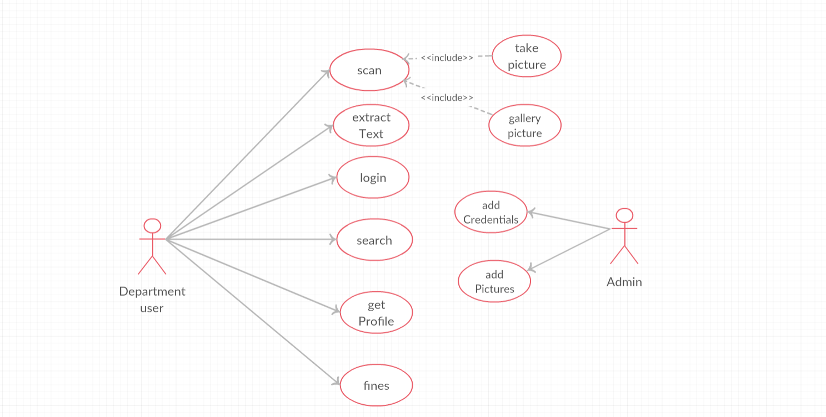
Use-case diagram

Slide 12
Project Schedule:
Week | Task | Status
week1 | Requirement Gathering | Completed
week2 | Design and Analysis | Completed
week3 | Implementation | Not Yet Completed
week4 | Testing | Not Yet Started

Slide 13
Working of Modules
This Application consists of mainly three modules.
They are: 1. User Interface
2.Optical Character Recognition
3. Database Retrieval

Slide 14
User Interface:
Login page displays the edit text fields to enter usernames and password.
Main Page will have Scan option, Import from gallery.
In the user details page the police has to check the rules violated like Rash Drive, Drunk and Drive, No Parking, No helmet, No license, etc.,

Slide 15
Optical Character Recognition
The police has to capture the image and that image gets scanned in the application using OCR Technology.
The scanned image is converted to text and displays in the text field.

Slide 16
Database Retrieval
After displaying the scanned text, we should click on the Search button.
This button invokes the connection with the database and the scanned text is compared with the records present in the database.
The details of the user like Image, Name, DOB, Address, Mobile Number, Previous Records etc.,
Based on the rules violated the corresponding fine will be generated.

Slide 17
References:
https://ieeexplore.ieee.org/document/6511640
https://ieeexplore.ieee.org/document/7193210

Slide 18
Comments

Slide 19
Thank you
Queries
?

